Slide 1
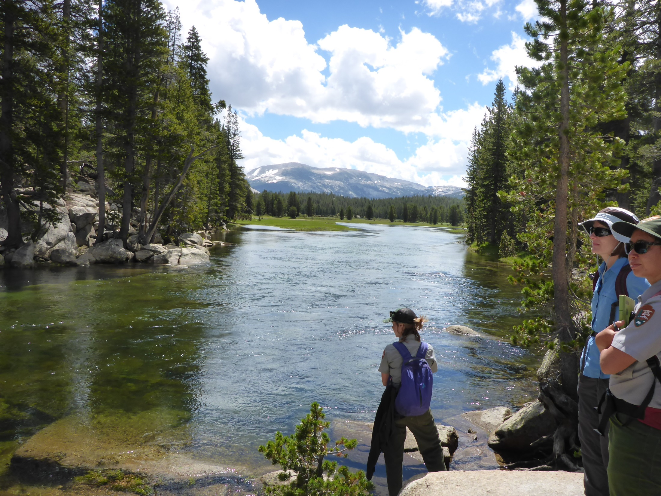
Tuolumne River at outlet of Tuolumne Meadows
Site installed 9/20/2017
Datum survey 9/25/2017
Photo: 7/25/2017

Slide 2
Gage installation, 9/20/2017
80 pound Solinst rock with Solinst
Solinst with mesh cover and two zip ties
Solinst rock on top of “Flat boulder”
Solinst pig-tail with 5mm keeper cord, washer, and double-fishermans stopper knot

Slide 3
Solinst boulder location
Solinst rock is 6 feet upstream from “Low water TD” on “Flat boulder”, underneath overhanging “slab boulder”
Solinst
boulder

Slide 4
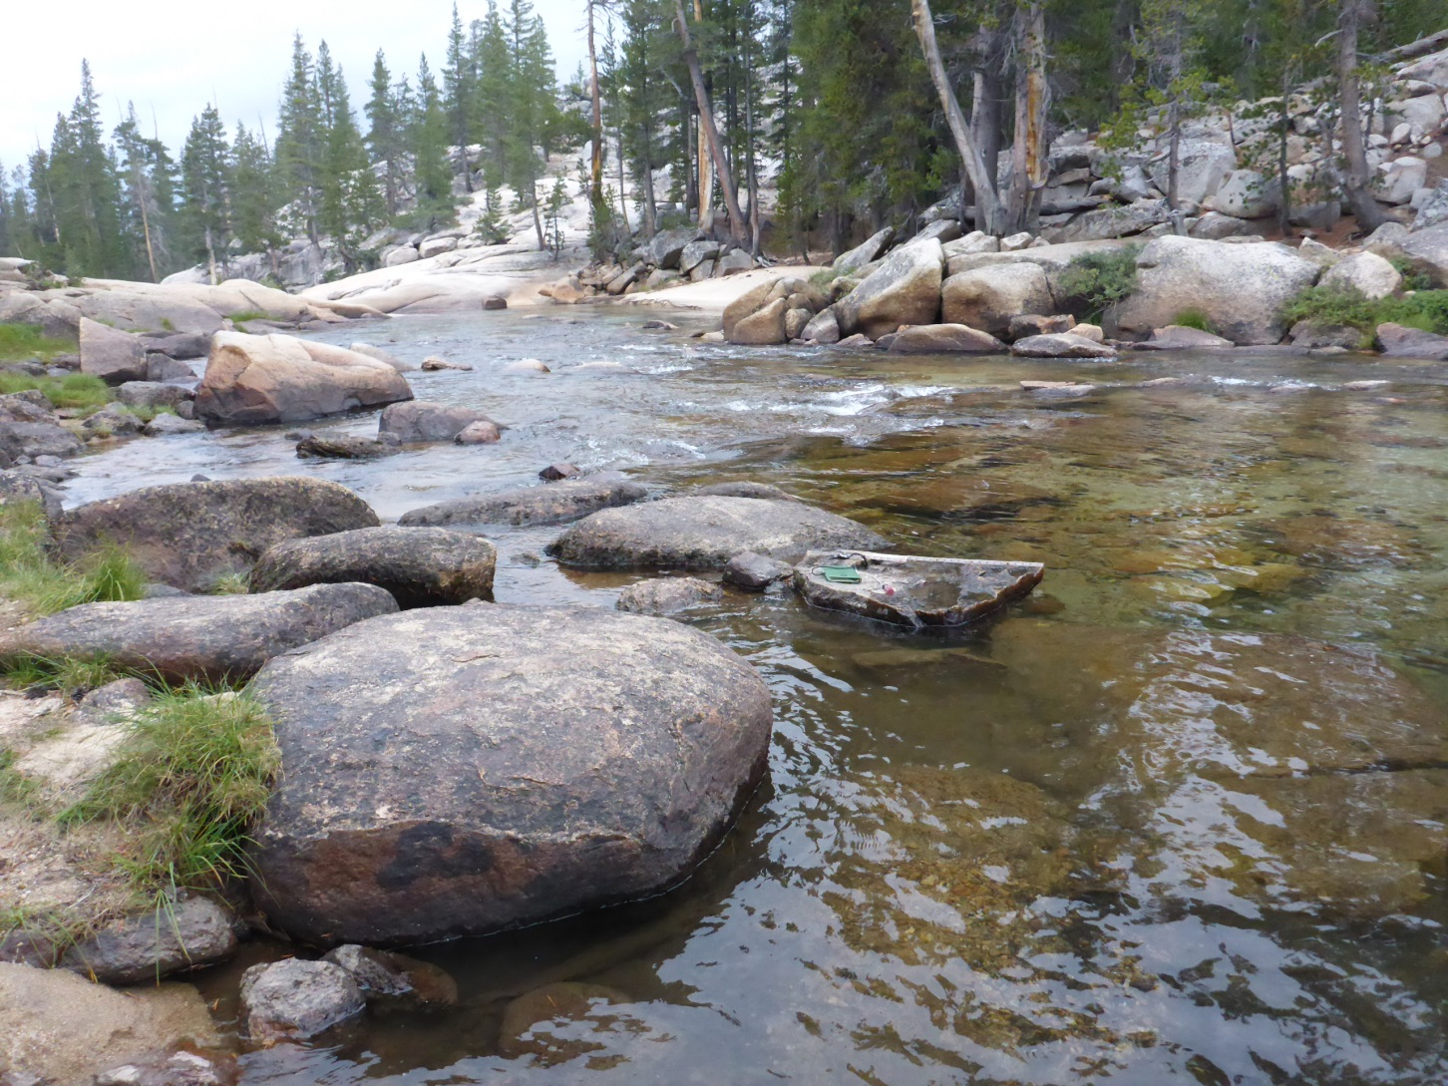
Gage datum with high water, mid water, and low water tapedown (TD).
High water TD
11.87 ft
Low water TD
9.46 ft
Mid water TD
10 ft

Slide 5
High water, mid water, low water tapedown locations
Mid water tapedown
Low water tapedown
High water tapedown from river left bank looking north
High water tapedown crystal
High water tapedown crystal
High water TD
crystal
High water TD
crystal
High water TD
crystal

Slide 6
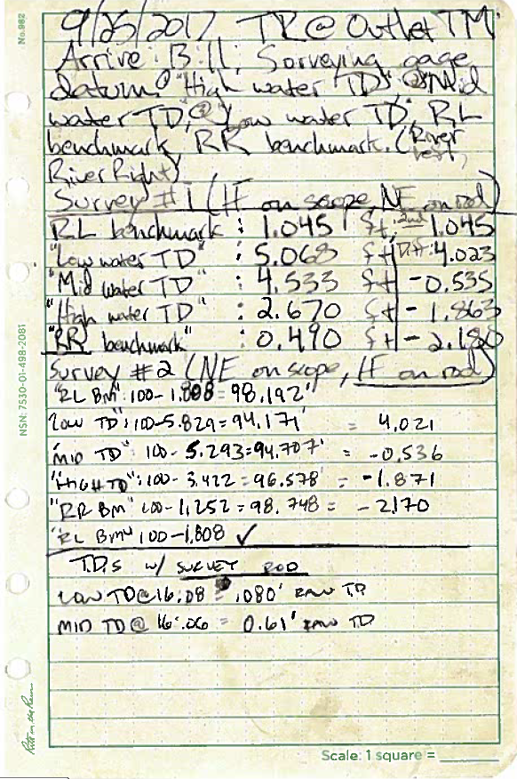
Gage datum survey data
River left benchmark
River right benchmark

Slide 7
River left benchmark
Midwater tapedown
Highwater tapedown
Highwater tapedown
River right benchmark
River right benchmark
River right benchmark
River left benchmark
Low water tapedown

Slide 8
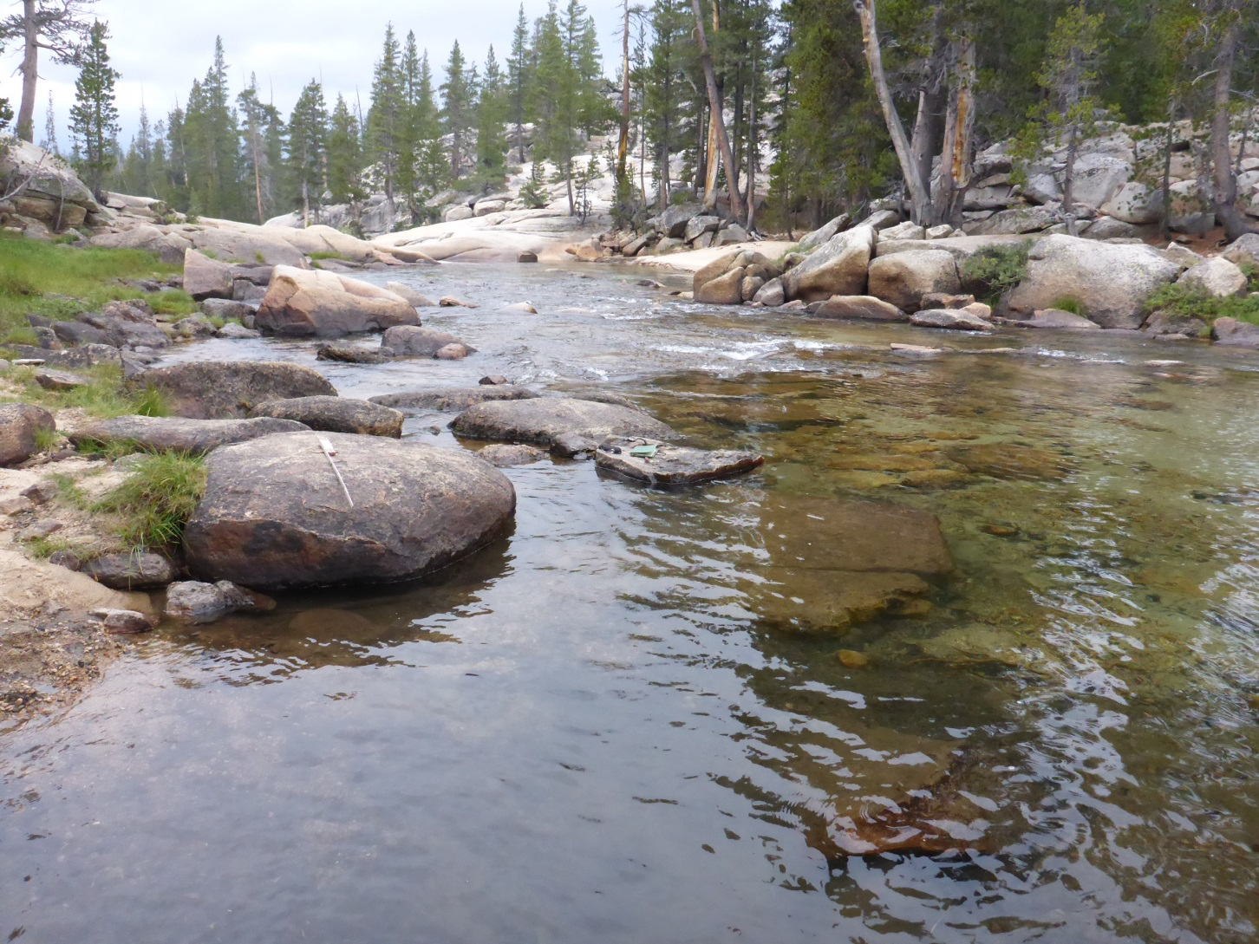
Section controls
High water control
Low water control

Slide 9
Section controls
Low water control
High water control
High water control
Low water control

